Slide 1
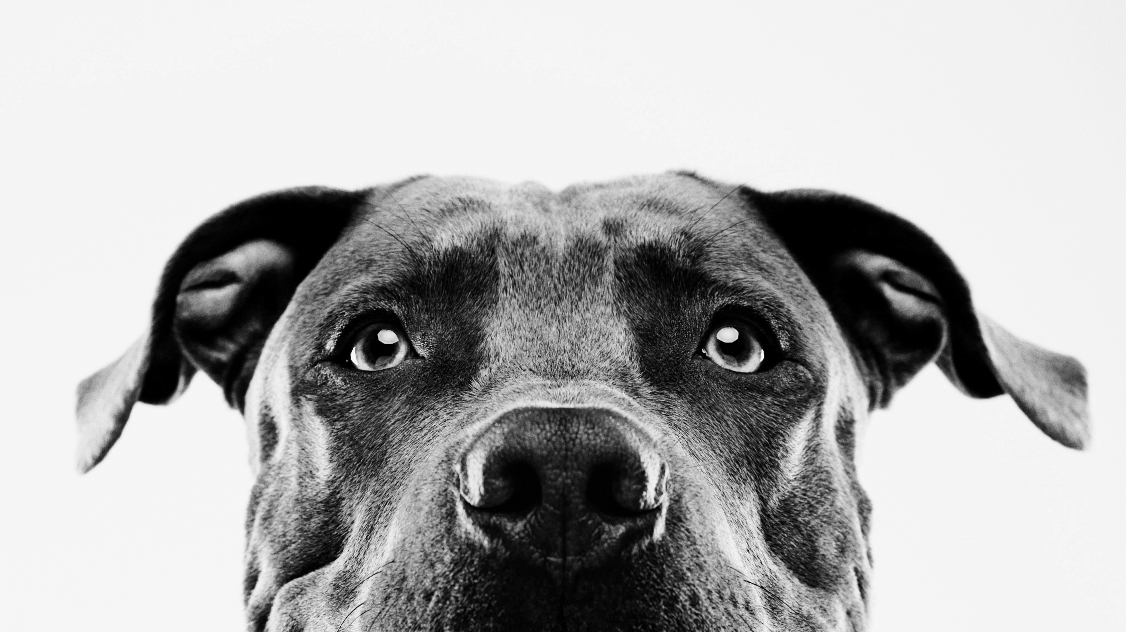
Austin Animal Shelter
Saving lives by the numbers

Slide 2
Mission Statement
Mission Statement
To provide public service and a safety net for lost and homeless animals in the community by providing necessary food, water, shelter and standard municipal veterinary care for animals in need.
To provide placement services that will assist lost, homeless or sheltered animals to their homes or find new homes when necessary, to provide live outcomes for at least 90% of sheltered animals.
To enforce animal regulations and assist the public with animal-related concerns, including impoundment, quarantine and other rabies control services in order to protect citizens and animals in our community.
To provide animal services to the public in order to educate and prevent animal homelessness and promote humane, compassionate treatment of animals and responsible pet ownership.

Slide 3
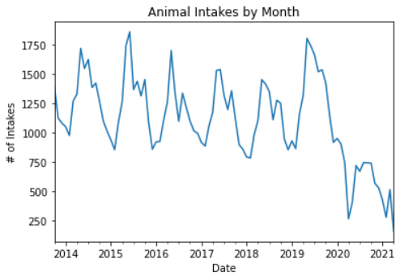
Animal intakes
Intakes cyclical in nature
Spring and summer are busiest due to breeding season
Peak of about 1750 intakes/month
COVID-19 lockdowns resulted in decreased volume
Peak of 750 intakes/month

Slide 4
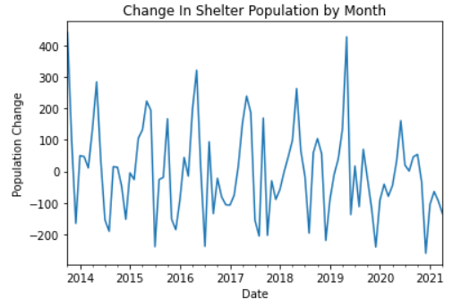
Shelter Population Change
Positive Values = Increase in population
Negative Values = Decrease in population
Shelter population increases dramatically in spring
Rest of year is focused on reducing population
COVID-19 hindered adoption efforts in 2020.

Slide 5
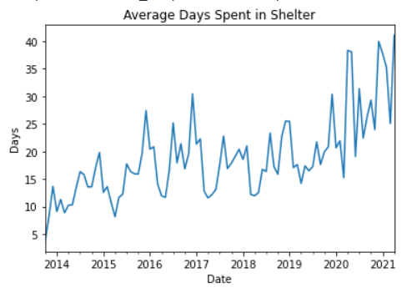
Days spent in shelter
Animals processed quickly during Spring/Summer
Slowly during winter months
Onset of lockdowns resulted in slower processing
Result of not allowing walk in adoptions and requiring appointments

Slide 6
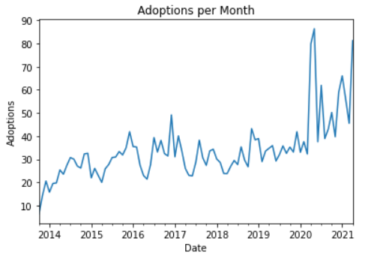
Adoptions Per Month
Adoptions per month steady at around 35 per month
Onset of lockdowns resulted in doubling of adoptions per month
Many individuals looking for companionship while at home

Slide 7
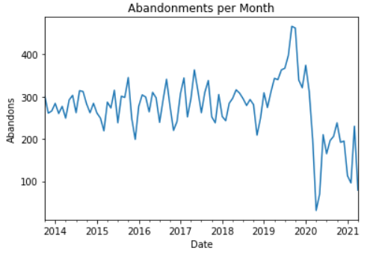
Abandoned Pets per Month
Abandoned pets steady until 2019
Large increase in abandoned pets during Summer 2019
Unclear what root cause is, require additional research into Austin area.
Large decrease in 2020 with onset of lockdowns
Due to spike in adoptions during same period, expect abandonments to spike dramatically in 2021-2022

Slide 8
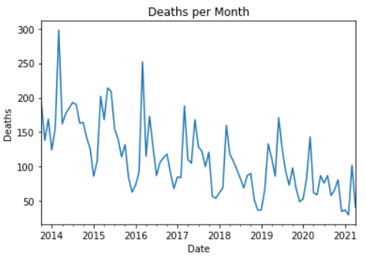
Deaths Per MOnth
Trending downwards from peak of 2014
Suggest shelter practices are improving over time
Good sign!

Slide 9
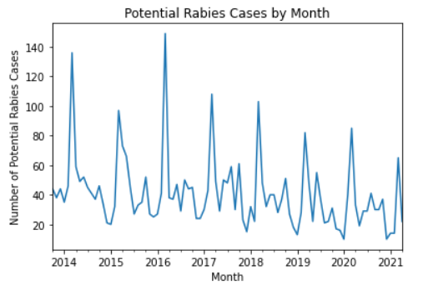
Rabies Risk
Rabies is an infectious disease
Infected animals have a 100% death rate
Extreme importance for public human and animal safety
Trending downwards starting in 2016
Suggest animal control programs are improving over time.

Slide 10
Adoption Times by Species
Used ANOVA and 2 sample T-tests to determine statistical significance
Confidence > 99%
Cats take nearly twice as long to adopt out
Resources should be directed at assisting cats preferentially over dogs and birds.

Slide 11
Conclusions
Dogs and birds adopted quickly.
Cats require more help
Predict increased shelter population in 2022 from increasing abandonment
Loss of life from Rabies and other factors down.

